Slide 1
Azure Machine Learning
[ Sathish Nadarajan ]
[ Nadarajan.sathish@gmail.com ]

Slide 2

Agenda
What is Machine Learning
Various Vendors
Microsoft
Amazon
Google etc.,
Machine Learning in Azure Cloud
Predictive Analytics
Azure Machine Learning Studio
Introduction about Key Concepts
Various Terms used in Machine Learning
Hands on Lab – A Simple Model Creation

Slide 3

























AI vs ML vs DL
Artificial Intelligence:
Robots
RPA (Robotic Process Automation)
IRT ( Interactive Response Technology)
Detections & Predictions
Machine Learning
Image Recognition
Voice to Text conversion
Predictions
Pattern / Fraud detection
Deep Learning
Driverless Cars / Drones
Languague Detection
Automatic colouring
Photo Metadata

Slide 4

What is Machine Learning?
Data Science technique, which allows the computers to use the existing data to forecast the future trends.
Branch of computer science in which a computer "learns" from data in order to perform predictive analytics
Credit-card fraud detection
Online shopping recommendations
Self-driving cars and more
Machine Learning finds patterns in large volumes of data and uses those patterns to perform predictive analysis
Supervised learning
Regression and classification
Unsupervised learning
Clustering
Notes:
1. Machine Learning finds patterns in large volumes of data and uses those patterns to perform predictive analysis.
2. Machine learning models fall into two broad categories:
supervised and unsupervised.
3. In supervised learning, the model is "trained" with a large volume of data and algorithms are then used to predict an outcome from future inputs. Most supervised learning models use regression algorithms to compute an outcome from a continuous set of possible outcomes (for example, your score on a test), or classification algorithms to compute the probability of an outcome from a finite set of possible outcomes (for example, the probability that an e-mail is spam or a credit-card transaction is fraudulent).
4. In unsupervised learning, the computer isn't trained, but is presented with a set of data and challenged to find relationships in it. K-Means Clustering is a common unsupervised learning algorithm. For a great explanation of how it works, see https://blog.intercom.io/machine-learning-way-easier-than-it-looks/.

Slide 5
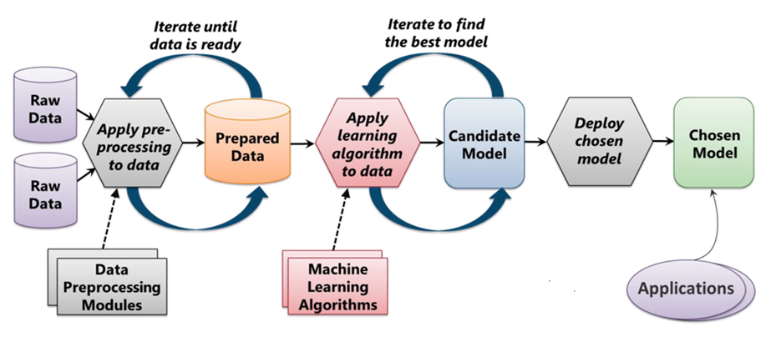
The Machine Learning Process
From "Introduction to Microsoft Azure" by David Chappell
Notes:
ML starts with data, which can come from a variety of sources. The data typically needs to be "cleaned" before it is used, and ML Studio includes modules to help with the cleaning. (Examples of cleaning include removing rows with missing data, replacing missing data algorithmically, removing duplicate rows, and removing rows containing "outliers." In practice, cleaning the data can be very time-intensive and often consumes 50% of the time required to build the model.) Once the data is ready, you select an algorithm and "train" the model by allowing it to iterate over the data and find patterns in it. After that comes scoring and evaluating the model, which tells you how well the model is able to predict outcomes. All of this is performed visually in ML Studio. Once the model is ready, a few button clicks deploy it as a Web service so it can be called from client apps.

Slide 6
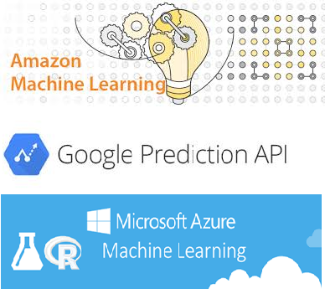
Various Vendors
Microsoft – Azure Machine Learning
Amazon – Amazon Machine Learning
Google – Google Prediction API
MATLAB
support traditional, non-cloud based ML modelling.

Slide 7
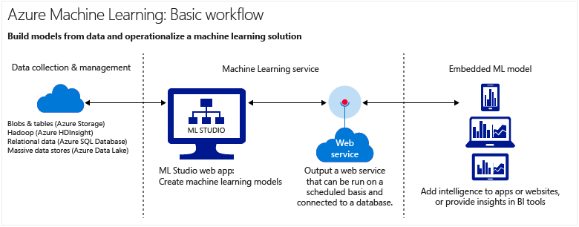
Azure Machine Learning in Cloud

Slide 8
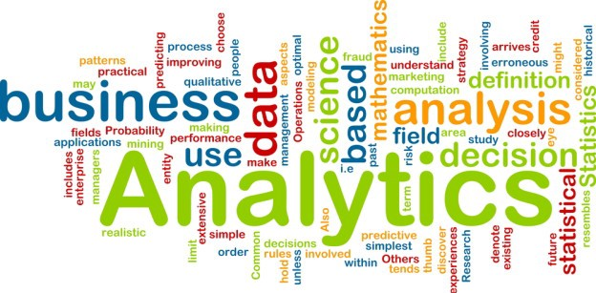
Analytics
Descriptive Analytics
Diagnostic Analytics
Predictive Analytics
Prescriptive Analytics
Notes:
Descriptive Analytics – What happened
Diagnostic Analytics – Why did it happen
Predictive Analytics – What will happen
Prescriptive Analytics – How can we make it happen

Slide 9
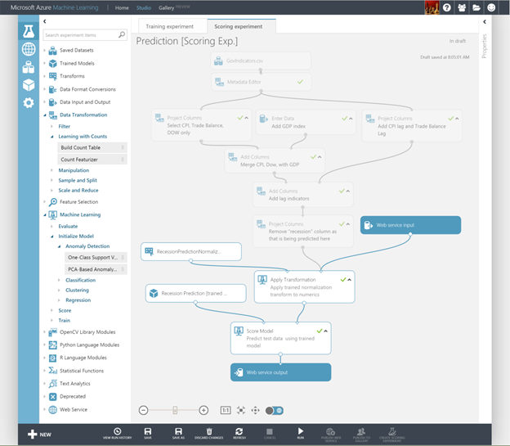
Azure Machine Learning Studio
Visual editor for composing, testing, refining, and deploying machine-learning models
Includes hundreds of modules
Includes common algorithms for classification, regression, and more
Supports numerous input formats
Supports R and Python
Machine learning for the masses
Notes:
ML Studio simplifies machine learning by providing a drag-and-drop model in which you build workflow. With ML Studio and the rich of assortment of modules it offers for modeling workflow, you can often build sophisticated models without writing a single line of code. However, it allows you to insert R and Python code anywhere in the workflow, providing infinite flexibility in what you can model.

Slide 10
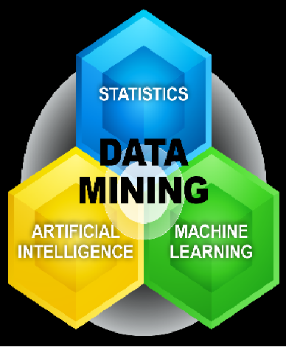
Key Concepts
Data Exploration
Data Mining
Descriptive Analytics
Predictive Analytics
Supervised Learning
Unsupervised Learning
Training and Evaluation
Notes:
Data exploration is the process of gathering information about a large and often unstructured data set in order to find characteristics for focused analysis.
Data mining refers to automated data exploration.
Descriptive analytics is the process of analyzing a data set in order to summarize what happened. The vast majority of business analytics - such as sales reports, web metrics, and social networks analysis - are descriptive.
Predictive analytics is the process of building models from historical or current data in order to forecast future outcomes.
Supervised and unsupervised learning
Supervised learning algorithms are trained with labeled data - in other words, data comprised of examples of the answers wanted. For instance, a model that identifies fraudulent credit card use would be trained from a data set with labeled data points of known fraudulent and valid charges. Most machine learning is supervised.
Unsupervised learning is used on data with no labels, and the goal is to find relationships in the data. For instance, you might want to find groupings of customer demographics with similar buying habits.
Model training and evaluation
A machine learning model is an abstraction of the question you are trying to answer or the outcome you want to predict. Models are trained and evaluated from existing data.
Training data
When you train a model from data, you use a known data set and make adjustments to the model based on the data characteristics to get the most accurate answer. In Azure Machine Learning, a model is built from an algorithm module that processes training data and functional modules, such as a scoring module.
In supervised learning, if you're training a fraud detection model, you use a set of transactions that are labeled as either fraudulent or valid. You split your data set randomly, and use part to train the model and part to test or evaluate the model.
Evaluation data
Once you have a trained model, evaluate the model using the remaining test data. You use data you already know the outcomes for, so that you can tell whether your model predicts accurately.

Slide 11
Common Terms
algorithm
anomaly detection:
categorical data:
classification:
feature engineering:
module:
model:
numerical data:
partition:
prediction:
regression:
score:
sample:
Notes:
algorithm: A self-contained set of rules used to solve problems through data processing, math, or automated reasoning.
anomaly detection: A model that flags unusual events or values and helps you discover problems. For example, credit card fraud detection looks for unusual purchases.
categorical data: Data that is organized by categories and that can be divided into groups. For example a categorical data set for autos could specify year, make, model, and price.
classification: A model for organizing data points into categories based on a data set for which category groupings are already known.
feature engineering: The process of extracting or selecting features related to a data set in order to enhance the data set and improve outcomes. For instance, airfare data could be enhanced by days of the week and holidays. See Feature selection and engineering in Azure Machine Learning.
module: A functional part in a Machine Learning Studio model, such as the Enter Data module that enables entering and editing small data sets. An algorithm is also a type of module in Machine Learning Studio.
model: A supervised learning model is the product of a machine learning experiment comprised of training data, an algorithm module, and functional modules, such as a Score Model module.
numerical data: Data that has meaning as measurements (continuous data) or counts (discrete data). Also referred to as quantitative data.
partition: The method by which you divide data into samples. See Partition and Sample for more information.
prediction: A prediction is a forecast of a value or values from a machine learning model. You might also see the term "predicted score." However, predicted scores are not the final output of a model. An evaluation of the model follows the score.
regression: A model for predicting a value based on independent variables, such as predicting the price of a car based on its year and make.
score: A predicted value generated from a trained classification or regression model, using the Score Model modulein Machine Learning Studio. Classification models also return a score for the probability of the predicted value. Once you've generated scores from a model, you can evaluate the model's accuracy using the Evaluate Model module.
sample: A part of a data set intended to be representative of the whole. Samples can be selected randomly or based on specific features of the data set.

Slide 12
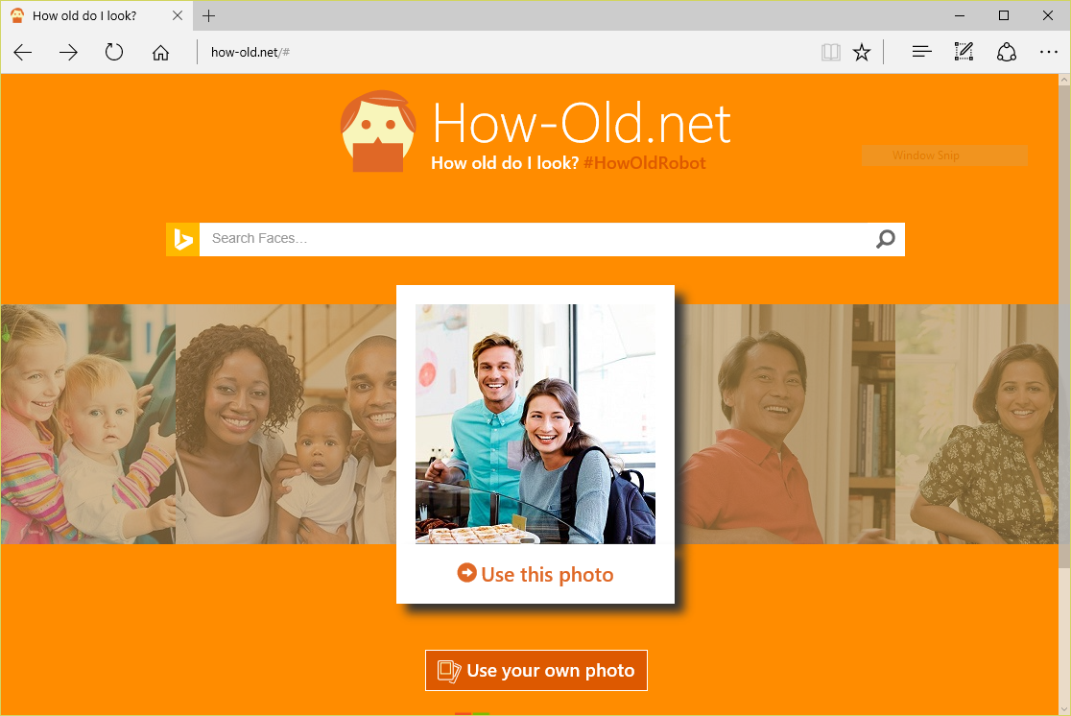
Machine Learning in Azure Cloud
Notes:
https://how-old.net/# offers a great example of machine learning in action. Created by Microsoft, the site uses advanced image-recognition techniques to analyze photos you upload and then uses an ML model to "predict" the ages of the people in the photos.

Slide 13
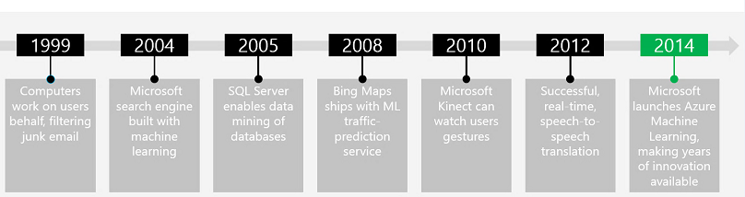


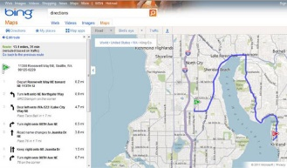

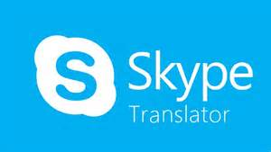
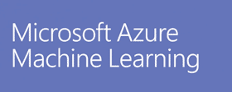

Microsoft and Machine Learning
Modified from http://pulsweb.fr/predict-wine-quality-azureml
Notes:
Microsoft has a rich history of employing machine learning in their products, beginning with the Silicon Valley company they purchased in 1999 and created Hotmail from. Hotmail used ML to perform advanced spam detection.

Slide 14
Azure Machine Learning
Fully managed cloud service for building and operationalizing ML models
Fully managed
Integrated
Best in Class Algorithms + R
Deploy in minutes
No software to install, no hardware to manage, and one portal to view and update.
Simple drag, drop and connect interface for Data Science. No need for programming for common tasks.
Built-in collection of best of breed algorithms. Support for R and popular CRAN packages.
Operationalize models with a single click. Monetize in Machine Learning Marketplace.
Notes:
Azure Machine Learning is a cloud-based predictive-analytics service that offers a streamlined experience for data scientists of all skill levels. It's accompanied by the Azure Machine Learning Studio (ML Studio), which is a browser-based tool that provides an easy to use, drag-and-drop interface for building machine-learning models. It comes with a library of time-saving experiments and features best-in-class algorithms developed and tested in the real world by Microsoft businesses such as Bing. And its built-in support for R and Python means you can build custom scripts to customize your model. Once you've built and trained your model in the ML Studio, you can easily expose it as a Web service that is consumable from a variety of programming languages, or share it with the community by placing it in the Cortana Intelligence Gallery.

Slide 15
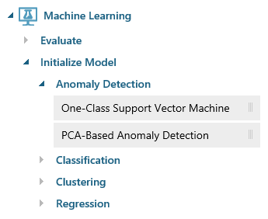
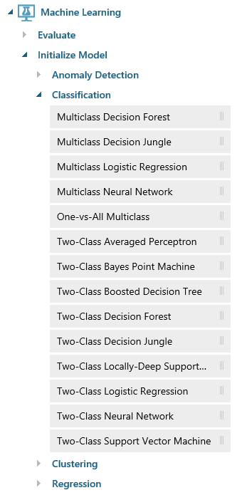
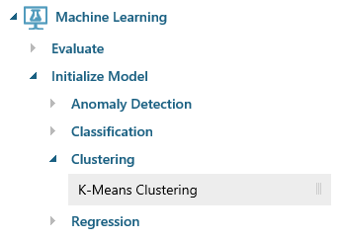
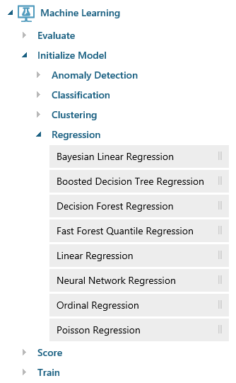
Azure Machine Learning Algorithms
Notes:
ML Studio provides canned implementations of 25 of the classic algorithms used in machine learning. It divides them into four categories.
Anomaly detection is the identification of items, events, or observations which do not conform to an expected pattern or other items in a dataset. A classic example is examining a dataset representing banking transactions and detecting potentially fraudulent transactions in that group.
Regression algorithms seek to establish and quantify relationships between variables. By establishing a relationship between a dependent variable and one or more independent variables, regression analysis can enable the value of a dependent variable to be predicted given a set of inputs with a quantifiable accuracy. A great example can be seen at https://how-old.net/#, a site that lets you upload a photo and then guesses your age with uncanny accuracy. The site uses Azure Machine Learning and combines classic regression with advanced image recognition.
The purpose of classification algorithms is to identify the category to which an observation belongs based on training data consisting of observations which have already been classified (assigned to a category). A great example is determining whether an e-mail belongs to the "spam" category or the "not-spam" category.
Clustering seeks to group a set of objects in such a way that objects in the same group (called a cluster) are more similar to each other than to those in other groups (clusters).

Slide 16
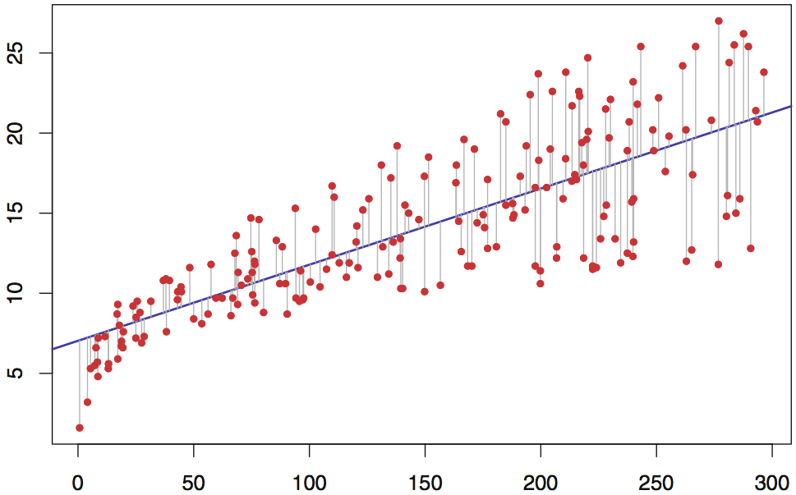
Simple (Univariate) Linear Regression
Regression line represented by an equation of the form Y = b₀ + b₁X where Y is the dependent variable
Error between actual and computed output minimized using least-squares or gradient-descent method
Notes:
Linear regression has been around for hundreds of years and is widely used in statistical modeling. The simplest form of linear regression (univariate) has one input variable and one output variable. Various techniques are used to best-fit a line (hence, LINEAR regression) to the data. Multivariate linear regression is similar, but adds additional terms to the equation (b2, b3, and so on).
Training a linear regression model with millions of values can take time, but once the model is trained, using it to perform predictive analysis is fast because "running" the model involves little more than solving an equation whose coefficients have already been computed (during training). This illustration can be used to explain why picking the right algorithm is key to building an effective model. If there is not a relatively linear relationship between input variable(s) and output variable(s), then linear regression won't produce a robust predictive model.
M = xbar * ybar – xy bar / Xbar Square – Xsqure bar
B = y bar – m xbar
Y = b + mx

Slide 17
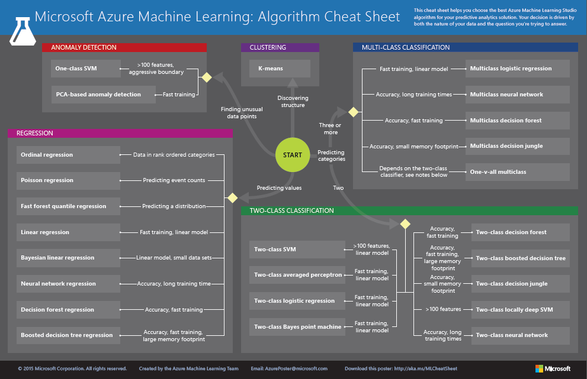
http://aka.ms/MLCheatSheet
Notes:
The Azure ML Cheat Sheet helps you pick the right algorithm for a model, even if you're not a trained data scientist. One example is if you want to use a set of input values to predict an output value from a continuous set of values (e.g., a person's age), use linear regression. But if you're more interested in the distribution of the output, you might use fast forest quantile regression instead. An example of when you would use the latter is using growth charts to assess child development. "Abby's height is in the 10% quantile of the heights of kids her age." Classification algorithms, by contrast, are used to predict a value from a discrete set of values -- for example, classifying an e-mail as spam or not spam.

Slide 18
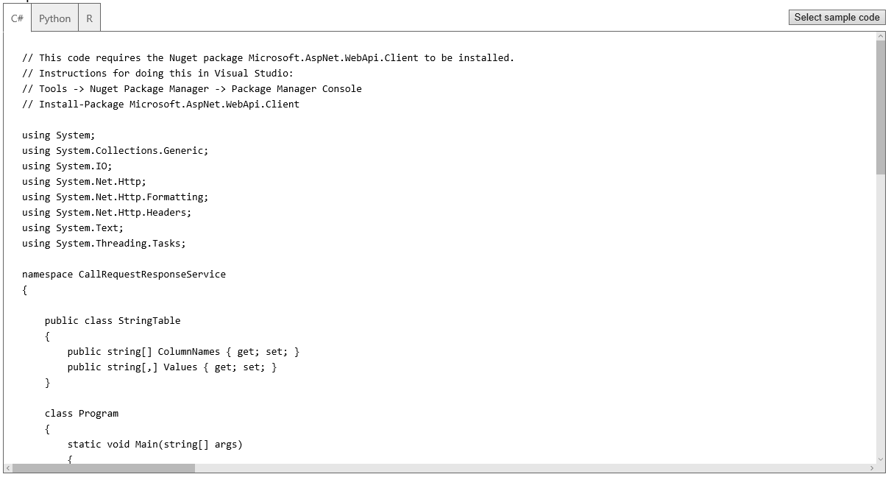
Deploying as a Web Service
A button click in ML Studio deploys a model as a Web service and provides sample code for calling it in three languages
Notes:
Once deployed as a Web service, a model can be used with simple REST calls over HTTP. This enables developers to build "smart apps" that get their intelligence from ML. In the next lab, students will build and train an ML model, deploy it as a Web service, and then write a client app that uses it.

Slide 19
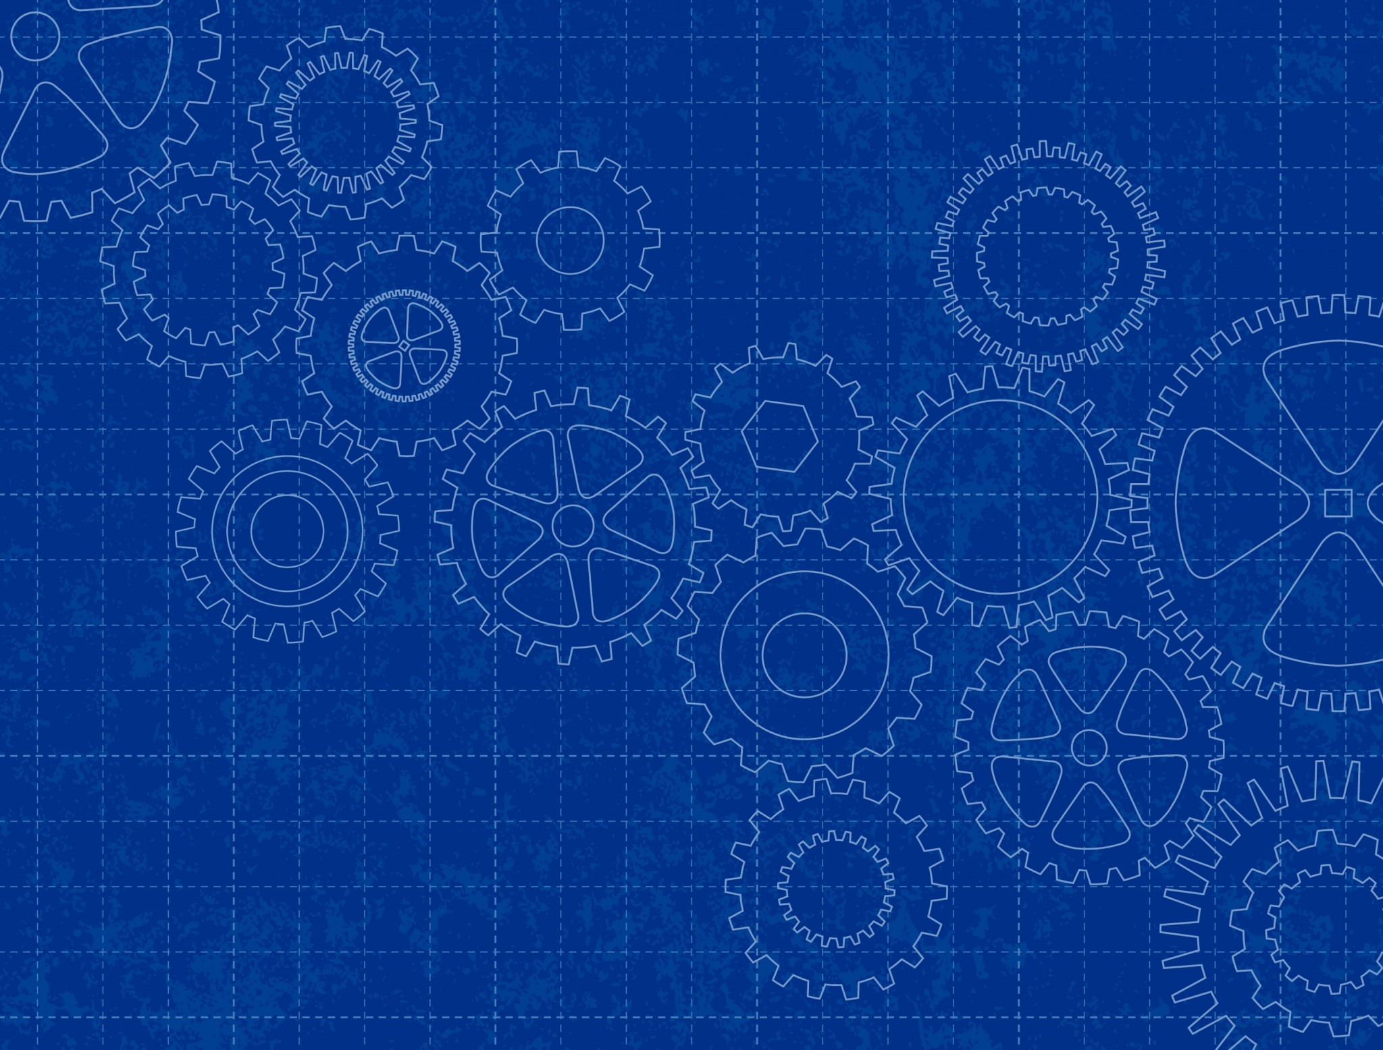
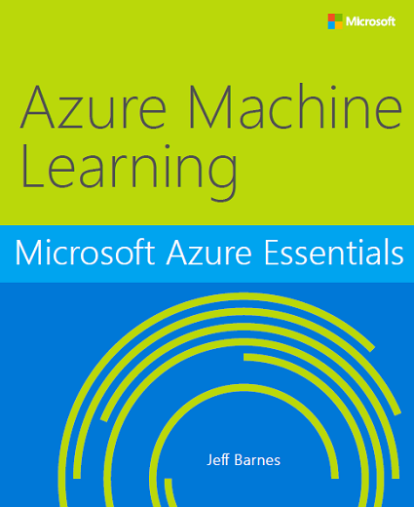
Free e-Book
http://bit.ly/a4r-mlbook
Notes:
Good book -- and free! Another recommended book on Azure Machine is Learning is "Predictive Analytics with Microsoft Azure Machine Learning " (https://www.amazon.com/Predictive-Analytics-Microsoft-Machine-Learning/dp/1484212010).

